Slide 1

Bluestock Mutual Fund Analytics
Data Analyst Internship Capstone project Presentation
by Lingutla Ranadeep

Slide 2




Problem & Objective
The Problem
The Objective
Retail investors often lack accessible, data-driven insights into mutual fund performance, inherent risks, and broader market trends.
Develop an end-to-end analytics solution to extract, process, and visualize critical mutual fund data.
Provide interactive dashboards that deliver deep insights into industry AUM growth, SIP continuity, and advanced risk metrics (VaR, CVaR, Sharpe Ratio).
Traditional metrics fail to provide a comprehensive view of downside risk or investor behavior patterns, making informed decision-making difficult.

Slide 3






Key Data Sources
AMFI Industry Data
Historical NAV & Returns
Investor Demographics
Aggregated data from the Association of Mutual Funds in India tracking total Assets Under Management (AUM), total active folios, and industry-wide scheme counts.
Daily historical Net Asset Value (NAV) data to calculate crucial performance and risk metrics including 3-year returns, Alpha, and daily return distributions.
Transactional data detailing investment types (SIP vs Lumpsum), geographic distribution across states, and specific age-group participation metrics.

Slide 4









System Architecture
1. Data Processing
2. Data Storage
3. Visualization
Python (Pandas) utilized to construct a complete automated ETL pipeline. Extracted historical data, cleaned inconsistencies, and generated calculated risk metrics.
Structured the cleaned datasets into a robust SQLite relational database, enabling fast querying and efficient data modeling for downstream applications.
Developed highly interactive Power BI dashboards to perform exploratory and advanced analytics, delivering actionable insights to stakeholders.

Slide 5

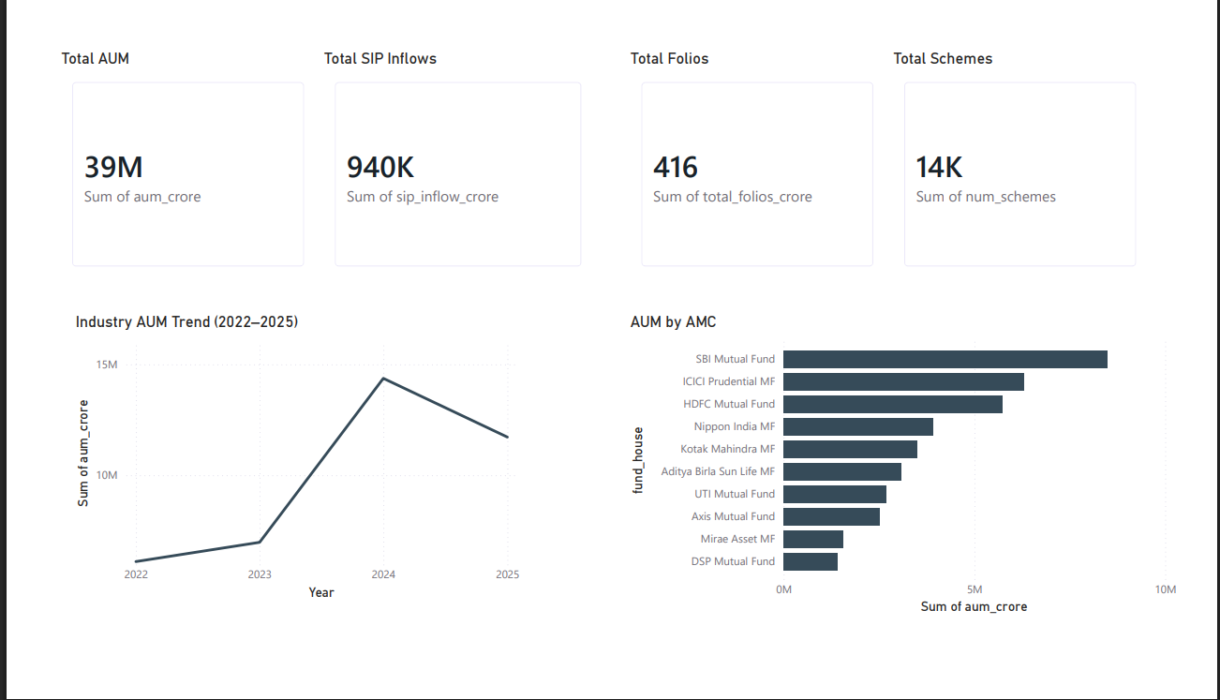
EDA Highlights: Industry Overview & Growth
Strong Macro Growth
Industry AUM showed strong growth trajectories between 2022 and 2025.
Record Highs
Total Assets Under Management reached a massive 39M Crore.
Widespread Adoption
Total Folios climbed to 416 Crore, encompassing roughly 14K active schemes.
Market Leaders
SBI Mutual Fund, ICICI Prudential, and HDFC Mutual Fund emerged as the dominant AMCs by AUM volume.

Slide 6

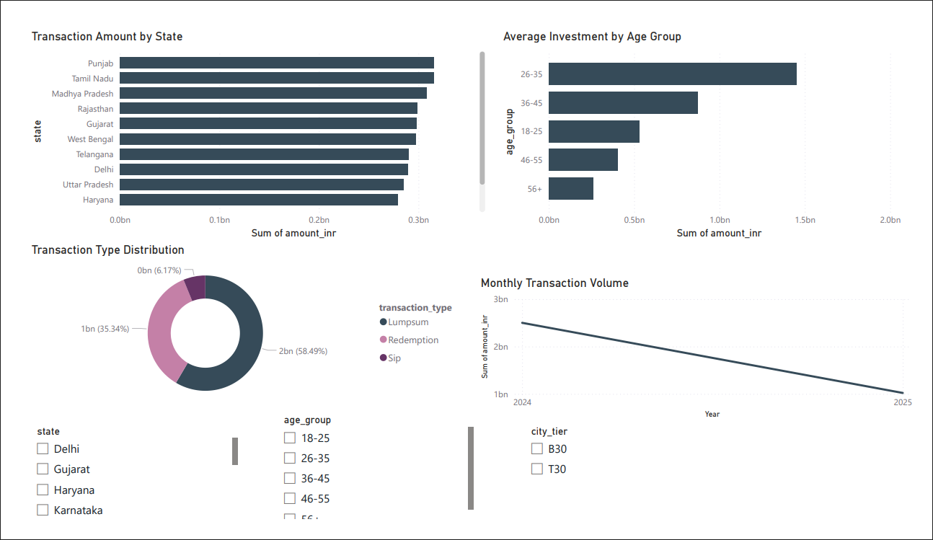
EDA Highlights: Investor Demographics
Young Investors Lead
Investors aged 26–45 represented the absolute most active investor segment by investment volume.
Transaction Preferences
Lumpsum investments accounted for the majority (58.49%) of transaction types, compared to SIPs (35.34%).
Geographic Concentration
Punjab, Tamil Nadu, and Madhya Pradesh registered the highest transaction amounts across states.

Slide 7
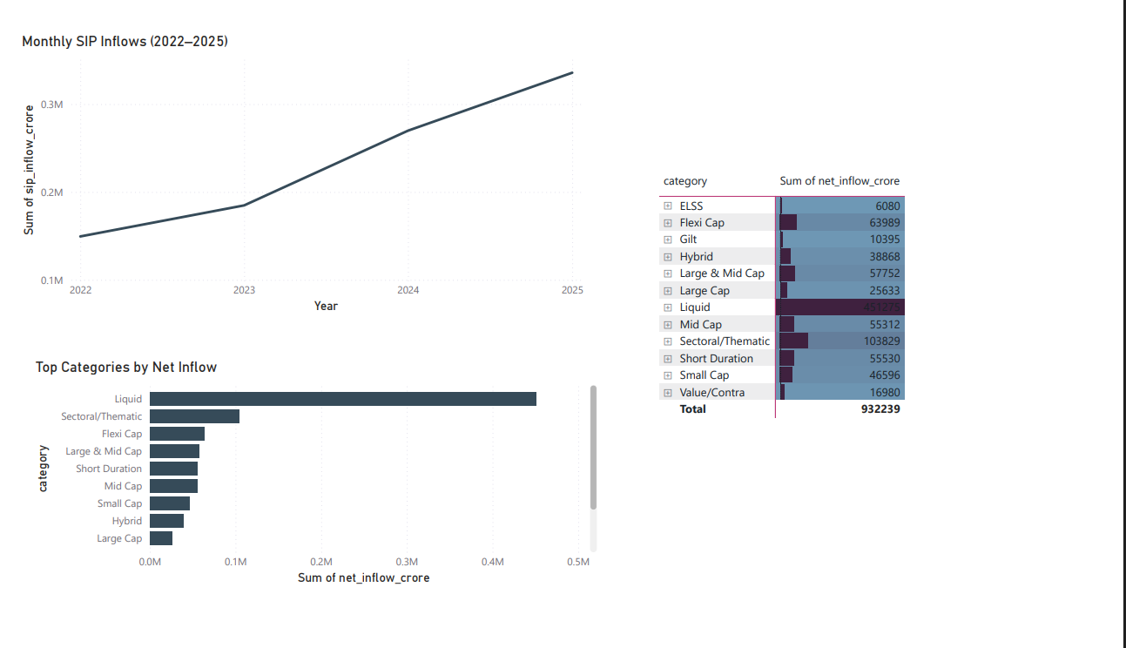
Performance Metrics: SIP & Market Trends
Consistent Upward Trend
Monthly SIP inflows increased consistently from 2022 to 2025, reaching ~940K Crore overall.
Category Preferences
Liquid funds received massive net inflows, remaining heavily popular for short-term liquidity needs.
Equity Interest
Sectoral/Thematic and Flexi Cap funds attracted the highest investor interest within equity-oriented categories.
Retail Confidence
Rising inflows indicate strong retail confidence in long-term wealth creation.

Slide 8
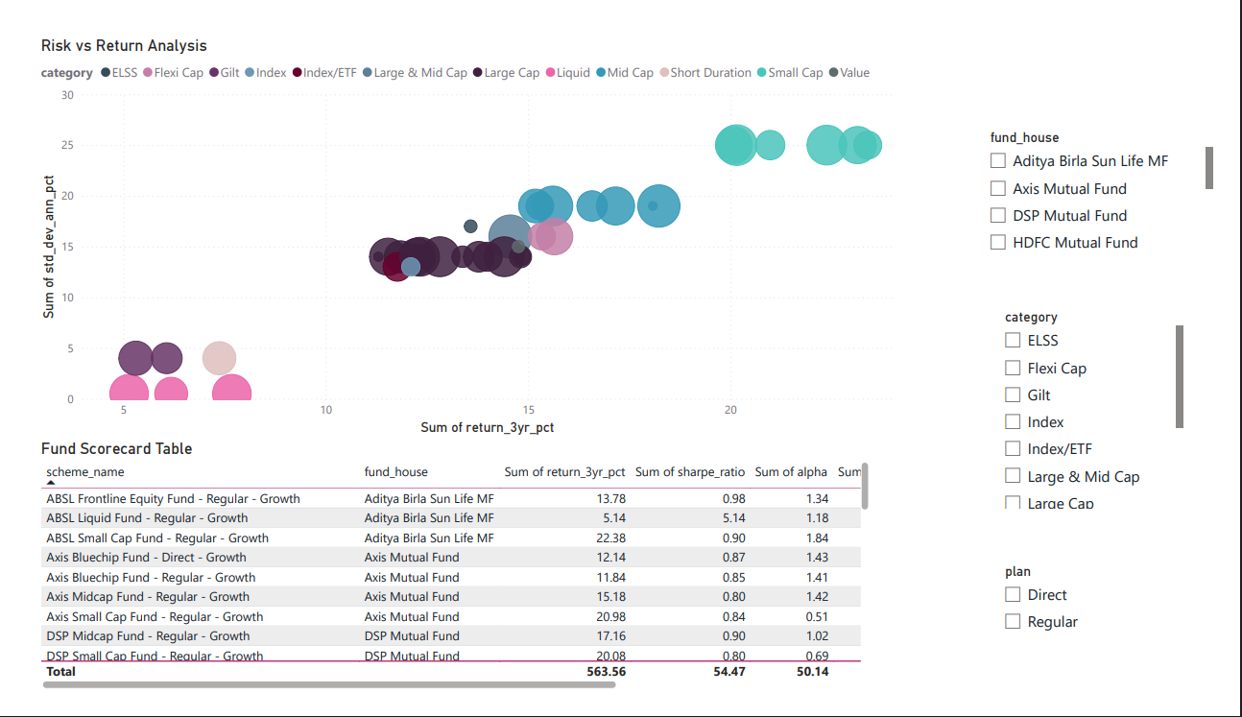
Performance Metrics: Risk & Advanced Analytics
Risk vs Return Analysis: The Trade-off
Small-cap and mid-cap funds delivered the highest returns (20%+) but exhibited significantly higher volatility (Std Dev).
Advanced Risk Metrics
Calculated historical VaR, CVaR, and Rolling Sharpe Ratios to identify potential downside risk across various schemes.
Risk-Adjusted Leaders
Funds with higher Sharpe Ratios (e.g., ABSL Frontline, DSP Midcap) consistently delivered superior risk-adjusted performance.
Sector Concentration
Measured sector concentration risk using the Herfindahl-Hirschman Index (HHI) for robust portfolio analysis.

Slide 9


Dashboard Screenshots

Slide 10

Dashboard Screenshots

Slide 11



Key Findings & Impact
Major Observations
Business Impact
Sustained SIP growth proves it is the preferred investment route for retail investors.
Supports entirely data-driven investment decisions for end-users.
Advanced analytics revealed significant differences in true downside risk between visually similar funds.
Enables comprehensive comparison of mutual fund performance beyond standard returns.
SIP continuity analysis successfully identified large groups of investors at risk of discontinuing.
Helps identify critical investor behavior patterns for targeted marketing.
Younger demographics (26-45) are aggressively driving new market volume.
Improves overall understanding of portfolio risk and diversification strategies.

Slide 12


Conclusion & Future Scope
Project Achievements
Future Enhancements
•
Built a complete, automated ETL pipeline.
•
Machine Learning-based fund recommendations for higher accuracy.
•
Performed in-depth Exploratory & Advanced Analytics.
•
Developed highly interactive Power BI dashboards.
•
Predictive analytics to forecast and model investor behavior.
•
Implemented complex risk metrics (VaR, CVaR, HHI).
•
Real-time market and Net Asset Value (NAV) API integration.
•
Created a rule-based Fund Recommendation Engine.
•
Expansion of the dashboard into a full-scale web application.
Thank You!
Open for questions and feedback.

